Slide 1
Burglary
What is a Burglary
What is a Robbery
What is a Theft
What is an Assault

Slide 2
Burglary
Definition:
BURGLARY -- Unlawful entry of any fixed structure, vehicle, or vessel used for regular residence, industry, or business, with or without force, with the intent to commit a larceny.
ROBBERY -- The unlawful taking or attempted taking of property that is in the immediate possession of another, by force or threat of force.
LARCENY-THEFT -- Unlawful taking or attempted taking of property other than a motor vehicle (motor vehicle theft is a separate category) from the possession of another, by stealth, without force and without deceit, with intent to permanently deprive the owner of the property.

Slide 3
Burglary
Assault - Unlawful intentional inflicting, or attempted inflicting, of injury upon the person of another.
Aggravated Assault - Unlawful intentional inflicting of serious bodily injury or unlawful threat or attempt to inflict bodily injury or death by means of a deadly or dangerous weapon with or without actual infliction of injury.
Simple Assault - Unlawful intentional inflicting of less than serious bodily injury without a deadly or dangerous weapon or an attempt or threat to inflict bodily injury without a deadly or dangerous weapon.

Slide 5
Burglary
Impact on Victims
There are six major ways in which victims suffer from crime. They are:
1. Loss of property and money
2. Injury
3. Feelings and behavior that occur because of the shock, symptoms of post-traumatic stress disorder

Slide 6
Burglary
4. Ripple effects of the crime on the family and friends of the victim (concern about victim's welfare and their own).
5. The variety of inconveniences caused by the state's action of trying to identify, convict and hold an offender accountable.
6. Difficulties with the lack of access to specialized services, like victim support programs and problems with hospitals, insurance companies and welfare agencies.

Slide 8
Burglary
Preventive Measures
Reducing the Risk of a Burglary
1. Join or start a Neighborhood Watch. Your local police department has a crime prevention office or officer who will give you assistance.
2. Lock doors and windows.
3. Light the outside of the house; trim shrubs.
4. Install good dead-bolt locks, window gates and an alarm system.

Slide 9
Burglary
5. Ask a neighbor to keep an eye on things.
6. Make the house appear occupied. Use timers, and when on vacation, stop deliveries and arrange to have circulars collected, the lawn mowed and garbage put out.
7. Etch identifying numbers on valuables, and move them out of the bedroom, the first place a burglar looks.
8. Never open your door to a stranger; use a peephole, not a door chain.

Slide 10
Burglary
Mason County Crime Stats
Burglaries for last year= 404 county wide
Assaults for last year= 251 county wide
Robberys for last year= 10 county wide
Thefts for last year= 651 county wide
Vehicle thefts last year= 180 county wide

Slide 11
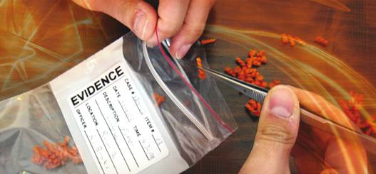
Burglary
How can you help with the investigation
Don’t touch anything if it can be avoided.
Document your valuables with photo’s.
Have serial numbers for items w/ photo’s.
Clean smooth surfaces are needed for finger prints.
Any observed person’s and/or evidence documented.

Slide 12
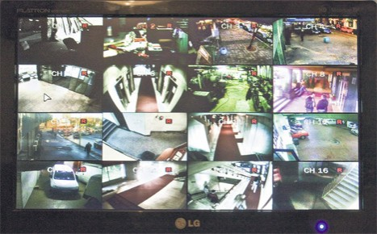
Burglary
Things to Think About
Alarms
Cameras
Video surveillance
Neighbors
Dogs
Fences

Slide 13
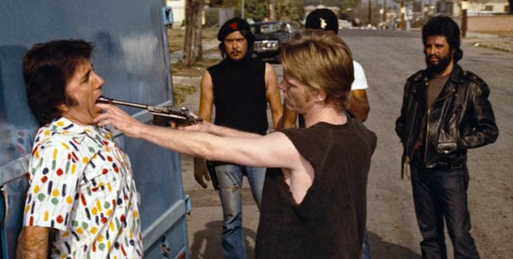
Additional Info
Reducing the Risk of Assault or Robbery
1. Avoid, as much as possible, being alone on foot at night or in isolated places, even during the day.
2. If out at night, stay in well lighted public places.
3. Carry a non-lethal protection device (e.g., whistle).

Slide 14
Additional Info
4. Lock car doors. Don't hesitate to use the horn, loudly, when danger is sensed.
5. Follow your instincts. If a situation "doesn't feel right," get out, get help, get among people.
6. Remember, many larger stores have security guards. Enter one quickly if danger is sensed. See nearest clerk.

Slide 15
Additional Info
7. Keep doors locked when home alone. Don't open door to strangers. Use peepholes, not chain.
8. Practice being conscious of who is in proximity and of a place to quickly go in event of emergency.

